Slide 1

The Italian Research Data Center:
work in progress
L. Bartiloro
Statistical Analysis Directorate
RDC and Innovation Lab Division
6th INEXDA Meeting
Paris, 21-22 November 2019

Slide 2
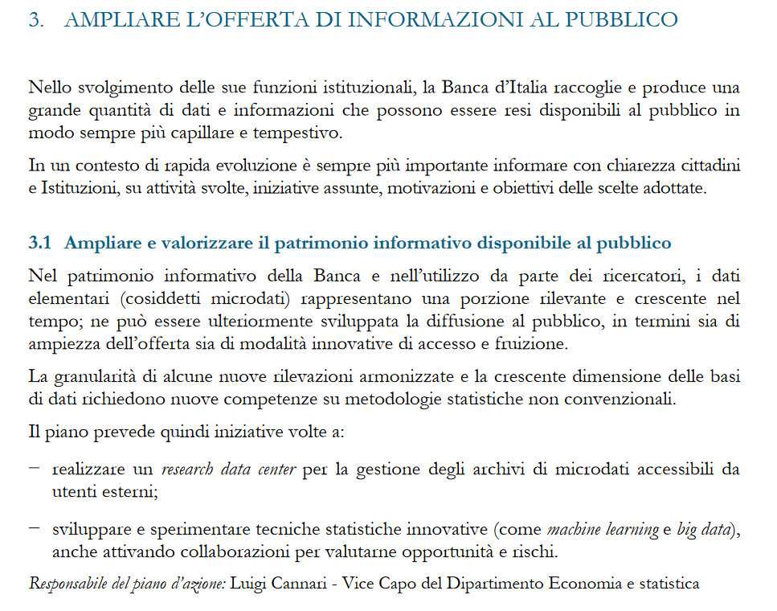

Our committment
6th INEXDA Meeting
Paris, 21-22 November 2019

Slide 3
GOALS
Facilitate the way internal and external users access microdata
Increase data availability
INSTRUMENTS
Improve methodology
PUF
BIRD
Web Tabulator
Lab
6th INEXDA Meeting
Paris, 21-22 November 2019

Slide 4
Other data producers
BI data producers
Data in other RDCs
RDC’s dataset
Inexda
BI economists
External economists
Other RDCs
6th INEXDA Meeting
Paris, 21-22 November 2019

Slide 5
Main tasks
Unique entry point for microdata information and archives
Create and manage the sites (web and intranet) describing the available databases and the related access modes
Increase and harmonize dissemination modes of the different databases
Data minimizing for confidential information
Centralized acquisition and managing of external databases
Perform standard database processing (es. merge)
Help and training for users
Manage datasets versioning (es. DOI attribution)
Repository, for reproducible economic research

Slide 6
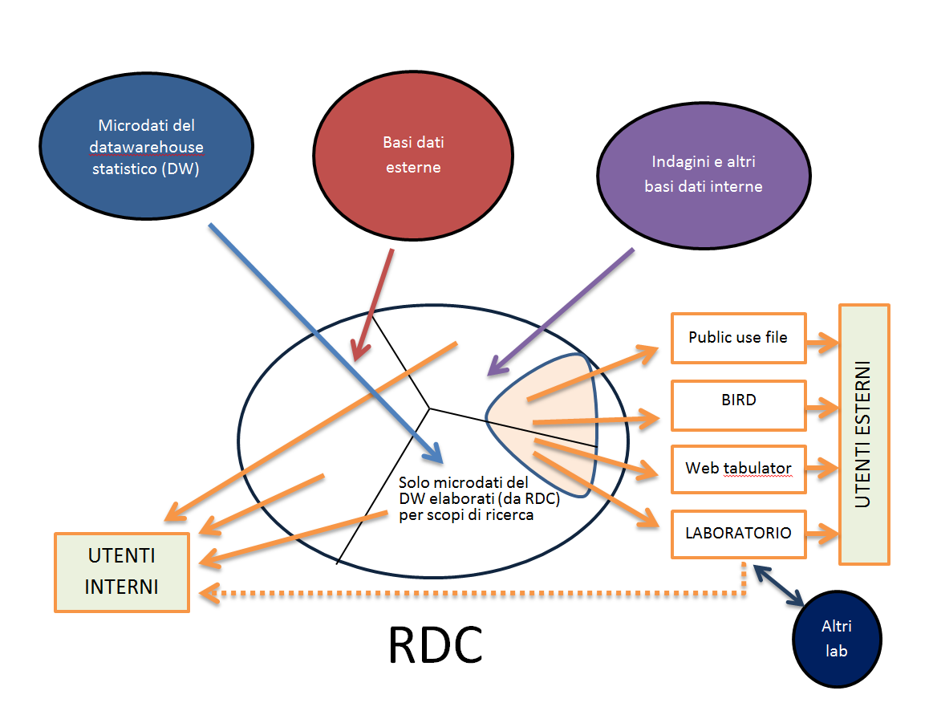
Outline
6th INEXDA Meeting
Paris, 21-22 November 2019

Slide 7
Users
External
More expert
Less expert
Internal
Economists
Only for research purposes
6th INEXDA Meeting
Paris, 21-22 November 2019

Slide 8
Granular data available to BI internal researchers
67 micro databases (for research purposes), half from internal source, half external.
Among those of internal sources, half derive from supervisory reports (but are reported for research purposes) while half come from surveys
So far, only 9 micro databases are available to the public (PUF e BIRD)
6th INEXDA Meeting
Paris, 21-22 November 2019

Slide 9
The granular data dissemination dilemma
Risk of re-identification
Utility
6th INEXDA Meeting
Paris, 21-22 November 2019

Slide 10
Granular data available to external researchers
Households and individuals
Survey of Household Income and Wealth (collected since 1962)
Eurosystem Survey data (HFCS – Italy, collected since 2010)
Financial literacy of Italian adults (collected since 2017)
International tourism survey (collected since 1966)
Firms
Survey of Industrial and Service Firms (collected since 1974)
Business Outlook Survey of Industrial and Service Firms (collected since 1993)
Survey of expectations of inflation and growth (collected since 1999)
Italian housing market survey short-term outlook (collected since 2009)
Survey on cross-border transactions in services by non-financial and insurance firms (collected since 2013)
6th INEXDA Meeting
Paris, 21-22 November 2019

Slide 11
External users:
elementary data
Households
PUF
(without identification variables: birth date and place, residency, day and hour of interview)
Firms
Restricted access
(without identification variables: name of firm, tax code, region, ATECO code)

Slide 12



External users:
elementary data
restricted use
Data confounding
But not all data can be easily anonimysed
Laboratory
Remote processing
6th INEXDA Meeting
Paris, 21-22 November 2019
Notes:
Households microdata in anonymous (Public Use File) form are available for download, starting from the 1977 Survey (for scientific research only)
Recently other microdata databases (e.g. survey on international tourism) have been added
Firms microdata cannot be easily anonimysed ➔ PUF seems very difficult to produce
➔ Data confounding (perturbed data): expensive and not always useful because the results (i.e. regressions) may heavily depend on the confounding technique adopted
➔ Data laboratory: solution costly and not always efficient, as it requires the user go to the lab in person
➔ BIRD (Bank of Italy Remote access to micro Data)
Remote processing solution, using internet, without direct access to individual data

Slide 13
Banca d'Italia Remote Data processing (BIRD)
The Bank of Italy's BIRD system allows processing of data collected through its surveys, while protecting the confidentiality of the individual data.
Available databases:
Survey of Industrial and Service Firms (since 1984)
Business Outlook Survey of Industrial and Service Firms (since 1993)
Survey of expectations of inflation and growth (since 1999)
Italian housing market survey short-term outlook (since 2009)
Survey on cross-border transactions in services by non-financial and insurance firms - direct reporting (since 2013).
In a next future, microdata on balance sheets of Italian banks
No direct access to elementary data!
6th INEXDA Meeting
Paris, 21-22 November 2019
Notes:
Users carry out their statistical and econometric analyses without having direct access to the micro data; they send an e-mail containing a program written in one of the prescribed languages and the system sends back an e-mail with the results of the calculations.

Slide 14


Input message is parsed and checks are performed, including content and logic
The user sends a message containing authentication info and the statements to be submitted (Stata and R)
6th INEXDA Meeting
Paris, 21-22 November 2019
Notes:
In March 2008 the Banca d’Italia started a system for remote processing of data collected for her Survey of Industrial and Service Firms, known as BIRD (Banca d’Italia Remote access to micro Data).
BIRD allows researchers to process data on industrial firms and non-financial private service firms collected since 1984, ensuring that individual information cannot be visualized.
The sistem also covers data from the Business Outlook Survey and was extended in 2013 also to microdata from the Survey on Inflation and Growth Expectations and on the Italian Housing Market Survey.
The researcher performs statistical and econometric analyses by submitting source programs by email and receiving output by email. Input and output alike are subjected to automatic and manual checks of their content and logic (for example, a command attempting to visualize individual data is automatically rejected)
Statistical packages supported by the system: Stata and R
How BIRD works:
The user sends a message containing authentication info and the statements to be submitted
Input message is parsed and checks are performed
If no error/security violation  submit statements
Output is parsed (automatically / manually)
If no security violation  forward to the user via e-mail
We also make available to researchers a device to test their program with fake figures, before submitting the program via BIRD

Slide 15
User
Data
Process
Confidentiality safeguards
6th INEXDA Meeting
Paris, 21-22 November 2019
Notes:
User level
Users are identified, qualified and registered
Registered mailboxes are whitelisted;
Outputs are monitored and archived
Deontological code, privacy law, specific penalties
Data level
Identifying variables (ids, names, addresses) are expunged from the datasets used for remote processing
Extreme data are censored (winsorized)
Stratification variables are collapsed (geographical areas and not regions; Ateco aggregations and not codes)
Processing level
Forbidden to display individual data
Keyword parser implemented with blacklist and graylist
Particularly long and/or complex programmes are always reviewed manually
In the learning stage, all submissions were reviewed manually

Slide 16


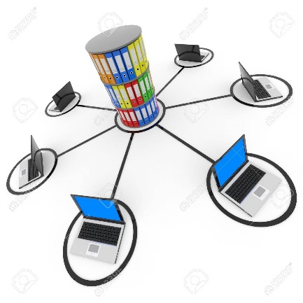


10 people among
Data scientists
Administrative staff
IT specialists
Work in progress
Logistics
IT solutions
(provided by IT Dept.)
Partners
6th INEXDA Meeting
Paris, 21-22 November 2019

Slide 17

Grazie
Email: laura.bartiloro@bancaditalia.it
6th INEXDA Meeting
Paris, 21-22 November 2019

