Slide 1


Update on 2nd workshop of the INEXDA Working Group on Data Access
Stefan Bender, Deutsche Bundesbank
Jannick Blaschke, Deutsche Bundesbank
Christian Hirsch, Deutsche Bundesbank
6th INEXDA Meeting
21-22 November 2019
Banque de France, Paris
The views expressed here do not necessarily reflect the opinion of the Deutsche Bundesbank, the INEXDA network, or the Eurosystem.

Slide 2
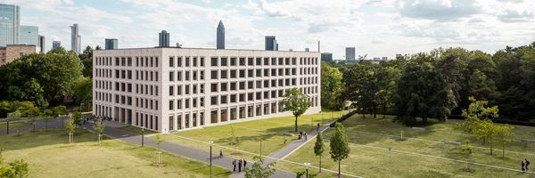
Recap: 1st Workshop of the INEXDA Working Group in April 2019
Background
A large number of exciting new projects are currently developed around the topic of data access.
Topics that were discussed include …
International access to microdata (Eurostat, CASD, Banque de France, UKDA)
Remote access (nearly all presentations, but SSB as the example)
Harmonizing data access (NordMAN, IDAN, INEXDA)
General principles including data access (Go FAIR, UWE)
Concepts: Output privacy, Input privacy problem, Sharing computation, SMC, (SDC)
Table Builder, On-the-fly-anonymization
Rich Context
Access modes
Classification of sensitive data
Training of researchers (and staff?)
Metadata
Standardization (data, procedures)
Data quality
Modern (EDRU) perspective: language and attitude
…

Slide 3
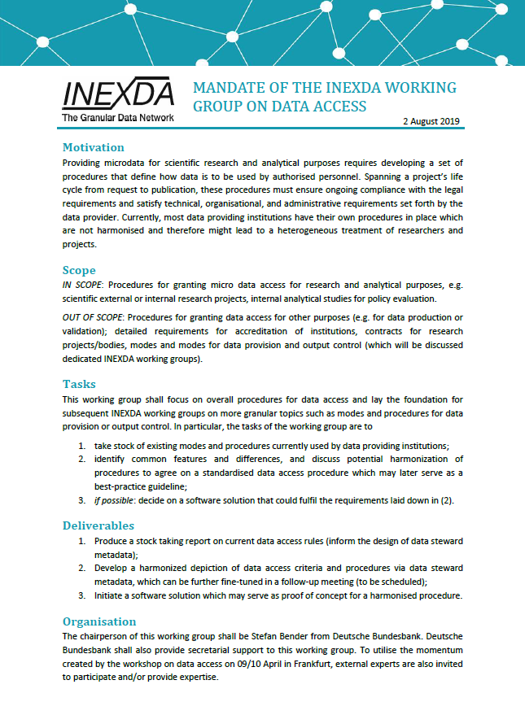
Recap: The mandate of the working group
Background
Focus of this workshop
Tasks
take stock of existing modes and procedures currently used by data providing institutions;
identify common features and differences, and discuss potential harmonization to agree on a standardised data access procedure which may later serve as a best-practice guideline;
Deliverables
Produce a stock taking report on current data access rules (inform the design of data steward metadata);
Develop a harmonized depiction of data access criteria and procedures via data steward metadata, which can be further fine-tuned in a follow-up meeting (to be scheduled);

Slide 4
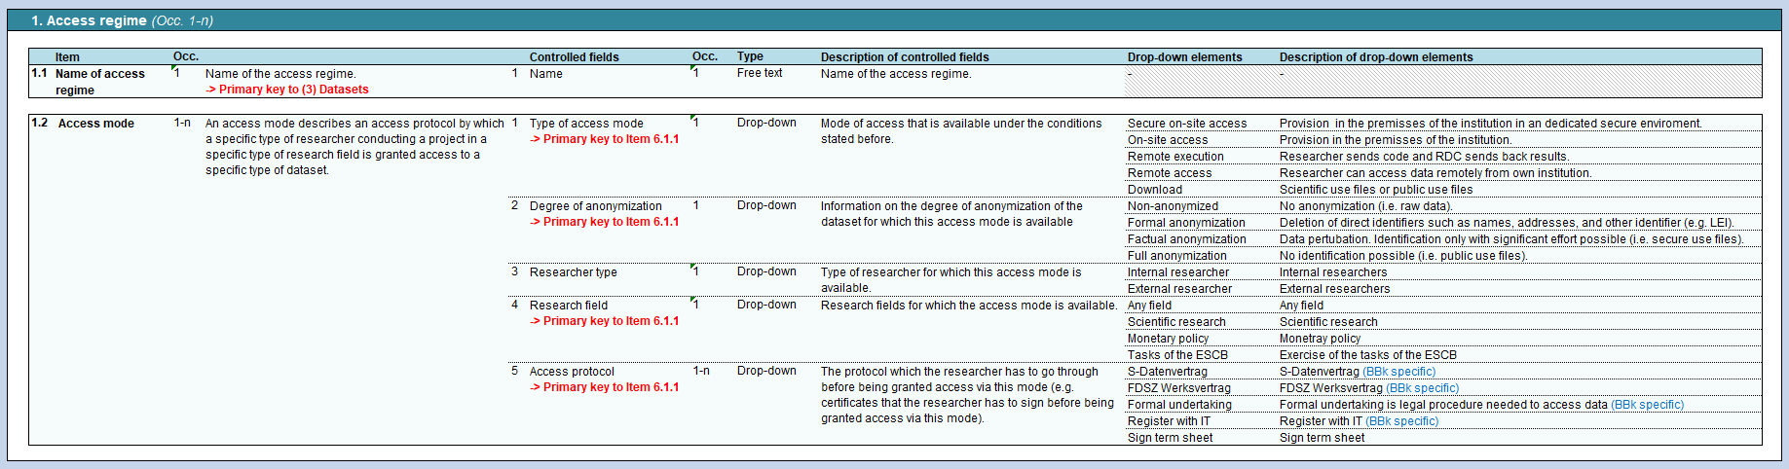
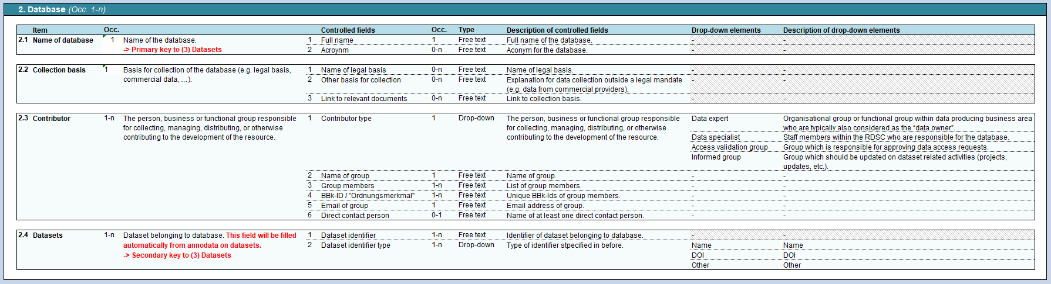
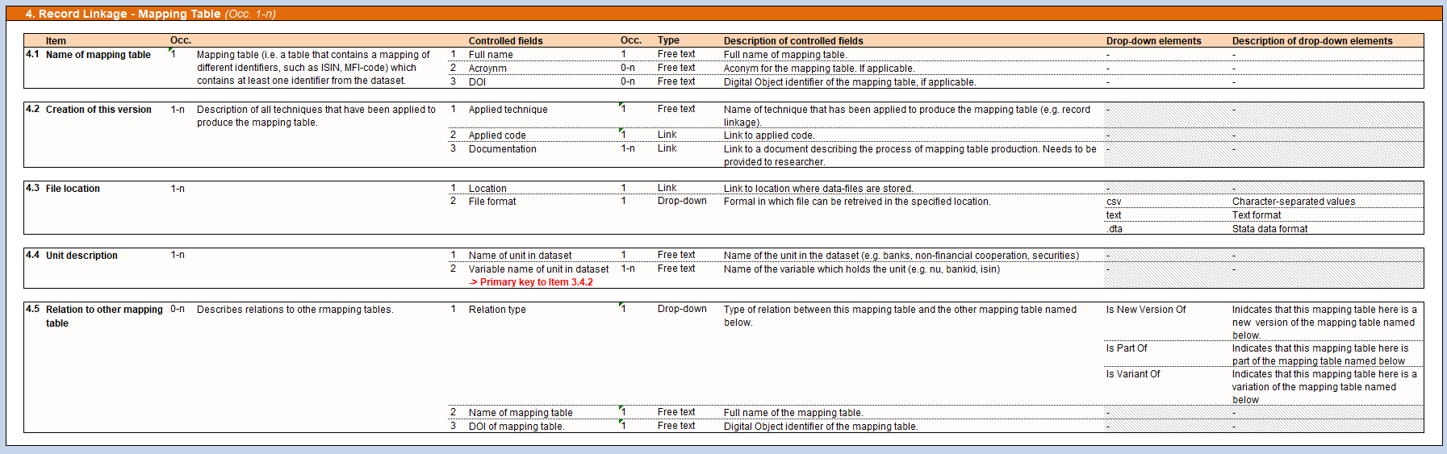
Schema to facilitate standardisation
Introduction to the annodata catalogue
Challenge:
Differences in legal, organizational and technical conditions as well as different terminology might complicate a discussion on data access procedures.
Idea: unified language
To facilitate the stocktaking of existing data access procedures BBk have drafted a set of metadata items (in the following annodata catalogue) designed to capture data access procedures currently used in data providing institutions.
In the last workshop all workshop participants discussed the suggested annodata items which have been amended by BBk accordingly.
BBk has published a technical report describing the general idea of annodata in “Bender, Blaschke, Doll, Gordon, Hirsch, Hochfellner, Lane (2019): The Annodata Framework: A data-centric approach to enhance metadata”. See
https://www.bundesbank.de/en/bundesbank/research/rdsc/data-access

Slide 5
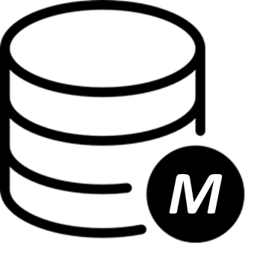
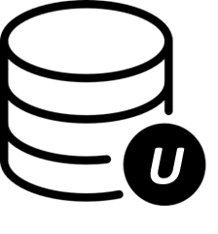
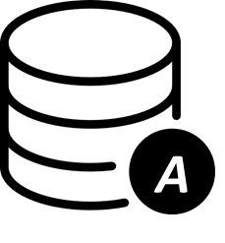
What information is needed for handing data?
Introduction to the annodata catalogue
Traditional Metadata
How is the data produced?
Usage Annodata
How are others using the data?
Administrative Annodata
How is the data managed?
Factsheet: (Administrative) Annodata
(Administrative) Annodata (~ annotation data) are structured information on the set of legal, technical, and organisational rules that make up data access procedures.
Main benefits from using Annodata:
Standardisation of legal, technical and organisational rules related to data access in and eventually also across institutions
Common standards allow harmonisation of data management
Automation of administrative processes to manage data
Easy adaptation of annodata-based software in other institutions

Slide 6









Eight types of annodata
Introduction to the annodata catalogue
Access regime
1
Database
2
Dataset family
(before: Dataset)
3
Record linkage
4
Combining restrictions
5
Global rules
(before: Decision rules)
6
Research projects
7
Researchers
8
1-3 on dataset family level
4-6 on global level
(i.e. irrespective of researcher affiliation, research field, and access mode)
7-8 on project level (to be discussed in 3rd workshop)

Slide 7
Factsheet: Access regime
Type 1: From legal, technical, and organisational requirements to access regimes
Definitions |  | Examples
(Data) access protocol | Criteria that have to be fulfilled to be granted access under a specific access mode. The protocol-criteria are imposed by a combination of the legal basis, the affiliation of the researcher, and the degree of anonymization of the requested data. | Application form, CV, RDC contract
(Data) access mode | Mode via which access can be granted (see five access modes in INEXDA Metadata Schema). | Secure on-site access, Download, No access
(Data) access regime | A collection of access protocols clustered in access modes. | Data collected under CR 2533/98
1, n
n, n
Access regime
Access mode
Access protocol

Slide 8

Example: Access regime
Type 1: From legal, technical, and organisational requirements to access regimes
Legal requirements
CR 2533/98 Art 8(1c):
“for granting scientific research bodies access to confidential statistical information which does not allow direct identification, […];“
Organisational requirements
…
Technical requirements
…
Access regime
Name: “Data collected under CR 2533/98”
Available access modes:
External researcher
Scientific research
Non-anonymised data
External researcher
Commercial purpose
Formally anony. data
External researcher
Scientific research
Formally anony. data
…

Slide 9
Annodata schema: Access regime
Type 1: From legal, technical, and organisational requirements to access regimes
1. Name of access regime
(Occ. 1)
1.1 Name
(Occ. 1)
Free text
Access regime
(Occ. 1-n)
2.1 Type of access mode
(Occ.1)
E.g. Secure on-site access, remote execution, download, …
2.2 Degree of anonymization
(Occ. 1)
E.g. Non-anonymized, formal anonymization, …
2. Access mode
(Occ. 1-n)
2.3 Researcher type
(Occ. 1)
E.g. Internal (limited rights), external (extended rights), …
2.4 Research field
(Occ. 1)
E.g. Scientific research, …
2.5 Access protocol
(Occ. 1-n)
Free text
* Occ. = Occurrence

Slide 10
Factsheet: Databases, -families and sets
Types 2 and 3: Relation between databases and datasets
While discussing the INEXDA annodata schema all participants agreed to introduce a “datasets family” as a new concept between the database and dataset.
This allows accommodating the fact that researchers may get access to the current dataset version as well as to future updated versions.
Definitions |  | Examples
Database | Collection of multiple datasets. | Money Market Statistical Reporting (MMSR)
Dataset family | Group of datasets, which only differ in their temporal coverage. | MMSR_formally-anonymised
Dataset | Subset of a database and a dataset family. | MMSR_2015-2018_formally-anonymised MMSR_2015-2019_formally-anonymised

Slide 11
Combining types 1, 2 and 3: Linking access regimes to dataset families
Fictional example: Structure of MMSR annodata
Database
Dataset family
Access regime
Access mode
Access protocol
MMSR_
formally-anonymised
Secure on-site access
Formally anonym.
External researcher
Scientific research
Application & CV
RDC contract
Formal undertaking
[…] _2016-17*
[…] _2016-18*
Secure on-site access
Formally anonym.
Internal researcher
Scientific research
Application
Line manager approval
[…] _2016-19*
MMSR
BBk_access_regime_1
…
…
MMSR_
non-anonymised
No access
Non-anonym.
External researcher
Scientific research
-
[…] _2016-17*
[…] _2016-18*
On-site access
Non-anonym.
Internal researcher
Scientific research
Application
Form A
Form B
[…] _2016-19*
* Datasets

Slide 12
Structure of annodata
Combining types 1, 2 and 3: Linking access regimes to dataset families
Database
1, n
n, 1
1, n
n, n
1,
n
Dataset family
Access regime
Access mode
Access protocol
Dataset
n, 1
Linking annodata items follows five main principles:
One database can have 1-n dataset families
One dataset family can have 1-n datasets
One dataset family can only be assigned to 1 access regime
One access regime can be assigned to 1-n dataset families
One access regime can have 1-n access modes
1
2
3
4
5

Slide 13
Why linkage information?
Type 4: The need for describing linkages
Focus so far: Research projects where only one dataset family was requested.
Now: Research projects where 1-n datasets families were requested.
 need for global (i.e. irrespective of researcher affiliation, research field, and access mode) rules
Necessary information to assess use of multiple datasets:
Record linkage – Can two or more datasets be linked from a technical perspective? Do dataset A and B have a common identifier so that they can be linked?
Combining restrictions – Are there any legal or organizational restrictions prohibiting combining the respective datasets? (to be discussed in 3rd workshop)

Slide 14
The idea of mapping tables
Type 4: The need for describing linkages
Dataset A
ID | VarA1 | VarA2
… | … | …
Dataset B
id | VarB1 | VarB2
… | … | …
Dataset C
Nr | VarC1 | VarC2
… | … | …
Dataset D
Name | VarD1 | VarD2
… | … | …
Mapping table 1
ID | id | Nr | Code
… | … | … | …
“Name” not included in “Mapping Table 1”. Therefore, dataset D cannot be mapped with A, B and C
Combined dataset
ID | id | Nr | VarA1 | VarA2 | VarB1 | VarB2 | VarC1 | VarC2
… | … | … | … | … | … | … | … | …
Identifier from dataset A, B and C
Variables from datasets A, B and C

Slide 15
Documentation is vital!
Type 4: The need for describing linkages
Transparency on all techniques that have been applied to produce the mapping table is essential to inform about …
scope of mapping
  e.g. if only a subset of dataset A can be linked with dataset B.
precision of mapping
  e.g. 80% of identifiers in dataset A are included in mapping table
other assumptions taken for record linkage mapping table
  e.g. historical vs contemporary links
Time dependency of mapping tables
  e.g. mapping is valid for time period 01-01-2016 until 01-01-2019
 This helps researchers assess whether the mapping is sufficient for their research purposes.

Slide 16
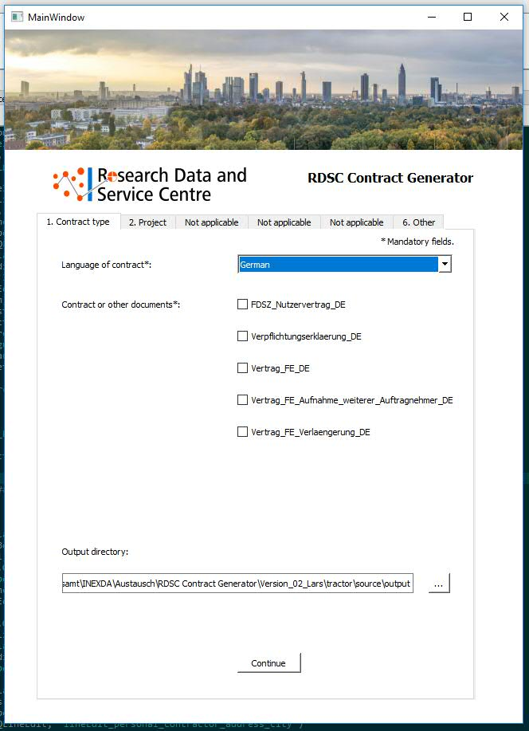
How annodata could be used in practice
DSM and its relation to the annodata catalogue
Annodata are both necessary and sufficient to conduct a structured stock-taking of data access procedures, establish comprehensive dataset descriptions and enable automated data-focused tools.
Proof of Concept 1: RDSC Contract Generator
Main features
Automatic generation of two selected documents (RDSC contract and form for formal undertaking)
Available in German and English
Simultaneous generation of multiple documents
Out of scope
Other contracts
Integration with RDSC’s research project database

Slide 17
Deliverables for 2020 and concrete next steps
Next steps: Outlook for 3rd Workshop on 18 Dec 2019 in Porto
Deliverable 1: Report of stock-taking
To reduce the burden on workshop participants, it was agreed to narrow the scope to (1) Access regimes, which will be used for the stock-taking.
Deliverable 2: Harmonised annodata schema
Publish the a second report with comprehensive (complete) annodata schema.
 | Actions | Deadline | Responsible
1. | Completion of stock-taking using “reduced” INEXDA annodata catalogue | 10 Nov 2019 | all members of working group
2. | Completion of evaluation of stock-taking | 17 Nov 2019 | BBk
3. | Presentation of first results at INEXDA Meeting in Paris | 21,22 Nov 2019 | BBk
4. | 3rd Workshop of the working group in Porto | 18 Dec 2019 | BdP
5. | Completion of draft report and circulation for comments to members of working group | Q1 2020 | BBk
6. | Publication of final report on INEXDA website | Q1 2020 | BBk

Slide 18
Many thanks!

