Slide 1
Data Room at Banco de Mexico
6th Meeting of INEXDA
Paris, Nov 21-22, 2019

Slide 2
Introduction
Since mid 1990’s, Banco de Mexico gathers granular data on financial transactions as part of its strategy to monitor regulatory compliance, risks taken by financial institutions, the development of markets and interactions between economic sectors. Furthermore, over the years, Banco de México has also gathered economic information for analysis and developed secure schemes to share economic microdata with other government entities.
All these developments have allowed the production of statistics and fostered financial and economic research.
As a result, microdata has the biggest share in Banco de Mexico’s current information model.
As the costs of such an information model are high to both the Central Bank that collects it and to reporting institutions, it is important to maximize its social benefits. To better achieve this, it is necessary to broaden the audience to the maximum of its capacity. Therefore, an efficient data sharing scheme is needed.
At the same time, it is important to preserve the confidentiality of sensitive data to avoid market distortions or an unlawful use. This would point towards a restricted dissemination. To balance both cases, it is necessary to think in alternative schemes that allow specialized users to have access to data in a secure way, but always fulfilling legal restrictions to disseminate it.
A Data Room is a potentially efficient scheme for sharing granular data that fits with these specifications.

Slide 3

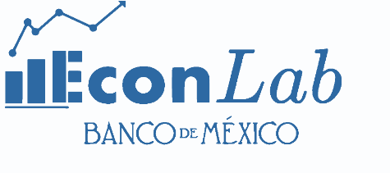

Why a Data Room?
There has been a growing recognition by the international community of expanding and improving information dissemination channels after the International Financial Crisis of 2008-2009.
Banco de Mexico considered the creation of a Data Room to share granular data for both internal and external users as a way to facilitate the access to data, increasing its value.
Economic data
Microdata at Banco de Mexico
Financial data
Access to specialized users
lisf
Operating
Since 2018
Mainly researchers co-authored with researchers from Banco de Mexico
Laboratorio de Información
del Sistema Financiero
Work in progress
Official release 2020

Slide 4
Economic Microdata Laboratory of Banco de Mexico (EconLab)
is the economic microdata laboratory of Banco de México.
It has been working formally since 2018 and has more than 20 ongoing research projects, collaborating with institutions such as Harvard University, the University of California, The Federal Reserve Board, and the BIS, among others.
The main goal for this laboratory is to foster economic research at the Bank by inviting non-for- profit researchers of the international community to collaborate in projects with Banco de Mexico.

Slide 5
EconLab
Information resources (microdata)
Banco de México has numerous databases for different purposes, several sources and distinct granularities.
EconLab staff is in charge of cleaning, harmonizing, anonymizing and, if necessary, creating aggregated databases making them friendlier for researchers.
Human resources
Access to the Bank’s specialists of each dataset.
The collaboration in a co-authorship scheme with a researcher at Banco de México offers access to the time and expertise of both the researcher and his/her research assistants.
Technological resources
The technological resources that are currently available at the research department can also be made available to external researchers while they are working at Banco de México. As of now, the EconLab has access to a server cluster at the Economic Research Virtual Laboratory (LVIE) that allows the execution of heavy routines and/or handling of large data sets.

Slide 6

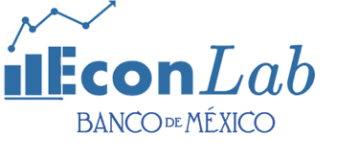



What is the EconLab?
Researcher
Research Project
A research project is required
Internal researcher (co-author)
Non disclosure agreement
Database secure on-site access or sample access
Banco de México
Data bases
Research data bases
LVIE
Secure on site access to servers with high computational power and statistical packages to process data
Different purposes (policy, statistics)
Several sources
Distinct granularities
For research purposes
External researchers allowed
Harmonization
Factual anonymization
Generate aggregates
Cleaning
Best practices

Slide 7
The Financial System Information Laboratory (LISF)
Purpose
1. Manage granular data sets to make them accessible and exploitable for specialized users.
Official release:
Contribute to expand the analysis and non-commercial research of specialized users, through secure access to large volumes of granular data.
Functions:
lisf
2. Guarantee the security and confidentiality of the information during the life of the project.
Laboratorio de Información
del Sistema Financiero
2020
3. Manage the library of information products generated from granular data.

Slide 8
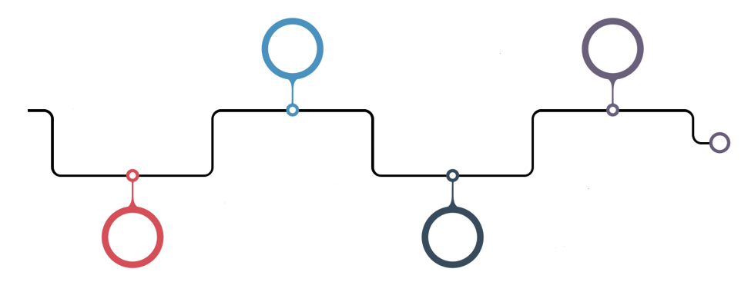



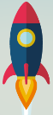
Timeline of the LISF
Implement the pilot test with internal users.
Implement a strategy to publicize and encourage the use of the first available granular data set to external users (1H-2020).
Official release 2H-2020.
General project planning and budgetary requirements.
2018
2019
2020
2021
…
Design, develop and implement policies, processes and management tools.
Define and ensure the implementation of the necessary infrastructure.
Design, develop and make available the first granular data sets.
Continuous improvement.
Advertising.
Analysis and evaluation of new granular information for publication.

Slide 9

Data Sharing Scheme to the LISF
Request data
Information of Financial Institutions
Specialized Users
lisf
Laboratorio de Información
del Sistema Financiero
.
.
.
Data available to user 1
Data available to user 2
Directorate of Financial System Information
…
…
…
Copying and mask specific large databases
Data available to user…
Data Factory
Data Dissemination

Slide 10
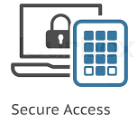
The Platform of the LISF
Main characteristics:
lisf
√ Physical environment
√ Secure computing environment
√ Safeguard personal data anonymity
√ Protocol
√ Services
Laboratorio de Información
del Sistema Financiero
Specialized Users
Granular Data
Organizational Security Policy
Organizational Security Standards
Security Management Processes
Access Control
Authentication
Confidentiality
Communication Security
Availability
Privacy
Governance

Slide 11
Where is the LISF now?
Currently, the LISF is work in progress.
Data that will be available:
Next steps:
Define the processes of production and exploitation of data sets, administration of the data repository and implementation of promotion strategies.
Design security rules to keep safe the data under exploitation processes.
The target by early of 2020 is to apply a pilot test.
In 2020 | In next years
Deposits and interbank loans (monthly) Consumer loans, different to credit cards (bimonthly) | Purchase of debt securities (daily) Securities repos (daily) Loan operations of debt securities (daily) Futures and Forwards (daily) Swaps (daily) Options (daily) FX transactions (daily)

